Slide 1
Heart Disease Prediction
Presented By- Aniket Manke, Anjalee Jaiswal
Nimra Khan, Priyanshu Gupta, Shubhodeep Sen

Slide 2
TOC
Overview
Building predictive system
Understanding the problems
Limitations
Project objective
Tools & Libraries
Features and Predictor
Conclusion and future work
Exploratory data analysis
Model training & getting model accuracy

Slide 3
Overview
WHO announced that cardiovascular diseases is the top one killer over the world. There are seventeen million people died from it every year, especially heart disease. Prevention is better than cure. If we can evaluate the risk of every patient who probably has heart disease, that is, not only patients but also everyone can do something earlier to keep illness away.
This database contains 14 physical attributes based on physical testing of a patient. Blood samples are taken and the patient also conducts a brief exercise test. The "goal" field refers to the presence of heart disease in the patient. It is integer (0 for no presence, 1 for presence). In general, to confirm 100% if a patient has heart disease can be quite an invasive process, so if we can create a model that accurately predicts the likelihood of heart disease, we can help avoid expensive and invasive procedures.

Slide 4
Understanding the problems
Our problem is that we want to predict whether patients have heart disease by given some features of users. This is important to medical fields. If such a prediction is accurate enough, we can not only avoid wrong diagnosis but also save human resources
01
02
When a patient without a heart disease is diagnosed with heart disease, he will fall into unnecessary panic and when a patient with heart disease is not diagnosed with heart disease, he will miss the best chance to cure his disease. Such wrong diagnosis is painful to both patients and hospitals.
03
With accurate predictions, we can solve the unnecessary trouble. Besides, if we can apply our machine learning tool into medical prediction, we will save human resource because we do not need complicated diagnosis process in hospitals

Slide 5
Project objective
Our project object is to detect whether patients have heart disease or not by given a number of features from patients. The motivation of our project is to save human resources in medical centers and improve accuracy of diagnosis. In our project we used different methods to visualise data and trained machine learning model to detect heart disease by using Logistic Regression model.

Slide 6
Features & Predictor:
1. age (#)
2. sex : 1= Male, 0= Female (Binary)
3. (cp)chest pain type (4 values -Ordinal):Value 1: typical angina ,Value 2: atypical angina, Value 3: non-anginal pain , Value 4: asymptomatic
4. (trestbps) resting blood pressure (#)
5. (chol) serum cholesterol in mg/dl (#)
6. (fbs)fasting blood sugar > 120 mg/dl(Binary)(1 = true; 0 = false)
7. (restecg) resting electrocardiography results(values 0,1,2)
8. (thalach) maximum heart rate achieved (#)
9. (exang) exercise induced angina (binary) (1 = yes; 0 = no)
10. (oldpeak) = ST depression induced by exercise relative to rest (#)
11. (slope) of the peak exercise ST segment (Ordinal) (Value 1: up sloping , Value 2: flat , Value 3: down sloping )
12. (ca) number of major vessels (0–3, Ordinal) colored by fluoroscopy
13. (thal) maximum heart rate achieved — (Ordinal): 3 = normal; 6 = fixed defect; 7 = reversible defect

Slide 7

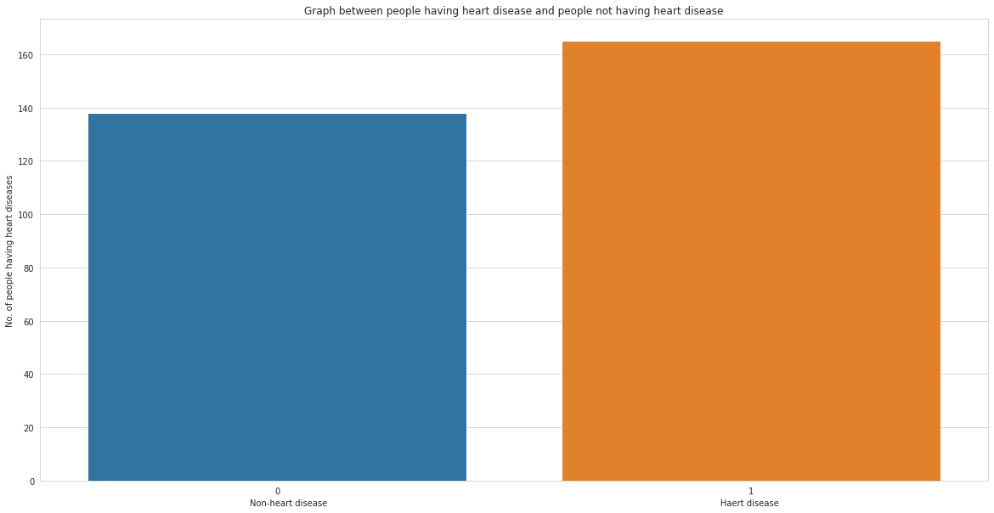
Graph between people having heart disease and people not having heart disease
People having heart disease are more than people not having heart disease.

Slide 8

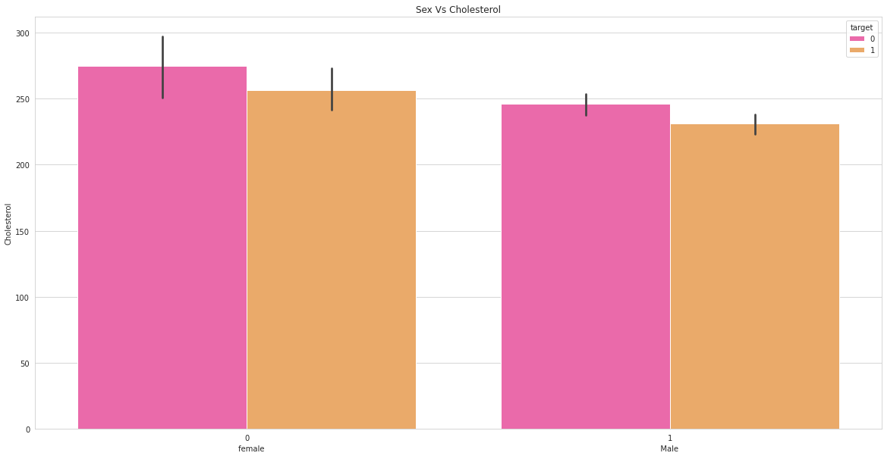
Graph between Sex and Cholesterol
Female not having heart disease has more cholesterol than female having heart disease.
And same trend can be seen in male.

Slide 9
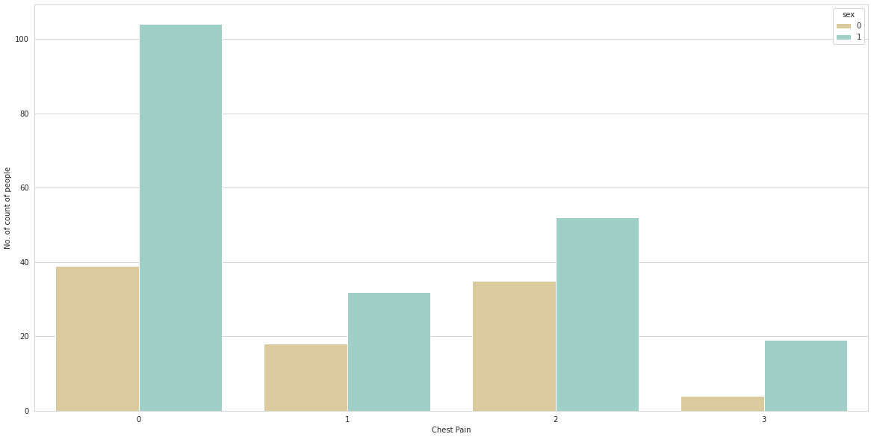
Graph of chest pain in males and females
There can be seen that there are more males having chest pain than female in all the types.

Slide 10
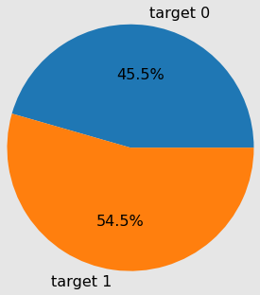
Pie chart of percentage of people having heart disease and not having heart disease
Target 0 → Non-heart disease
Target 1 → Heart disease
You can see that about 54.5% of people suffer from heart disease or there is a chance for heart disease to occur and about 45.5% people don’t have heart disease or its symptoms.

Slide 11
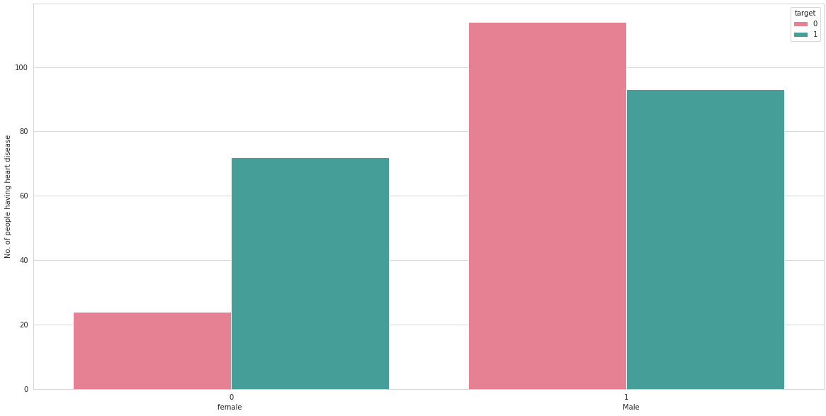
Graph between Sex and target
In females, we can see that having heart disease are more than not having heart disease.
In males, we can see that having heart disease is less than not having heart disease.

Slide 12
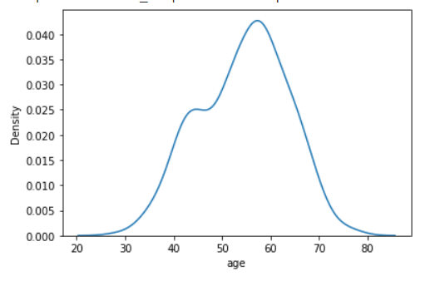
From the results we obtained, we note that the disease begins to spread at high rates at the age of 33 years and then intensifies in prevalence between approximately 43 to 46 years, and then continues to spread to reach the largest number of infections between approximately 50 to 58 years, and then begins to decline Gradually.

Slide 13

Model training and prediction
LOGISTIC REGRESSION MODEL
Logistic Regression is a Machine Learning classification algorithm that is used to predict the probability of a categorical dependent variable. In logistic regression, the dependent variable is a binary variable that contains data coded as 1 (yes, success, etc.) or 0 (no, failure, etc.). In other words, the logistic regression model predicts P(Y=1) as a function of X.

Slide 14
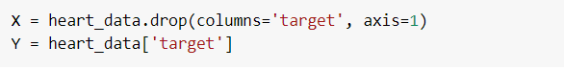
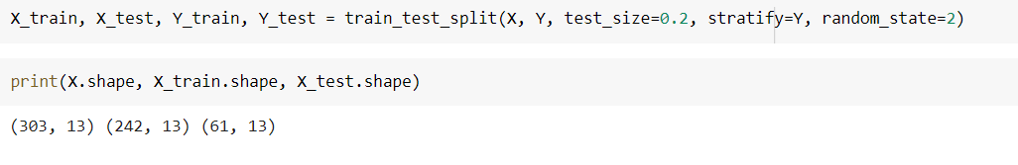
Prepare Data for Modeling
Assign the 13 features to X, & the last column to our classification predictor, y
Split: the data set into the Training set and Test set

Slide 15
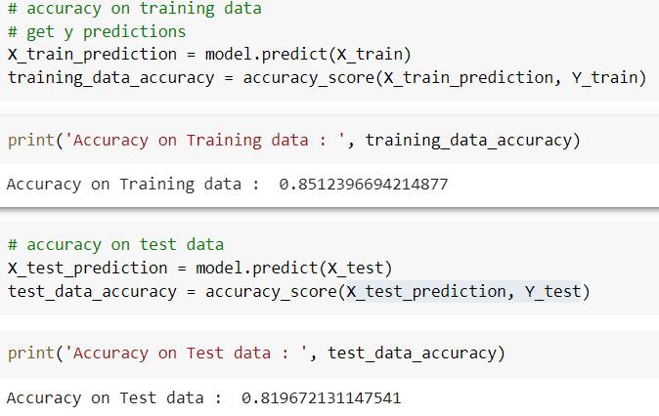
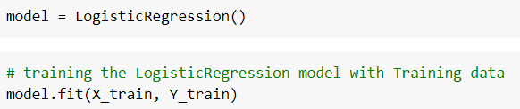
Spotlight on wearables
Here we have trained our model with training data.
Here we have got approximately 85.12% accuracy on training data and 81.96 % accuracy on testing data using logistic regression model.

Slide 16
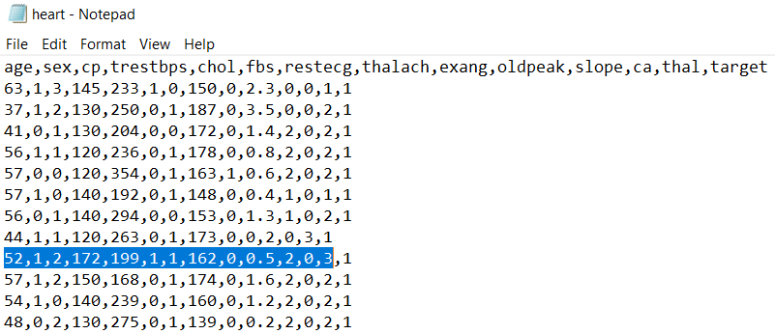
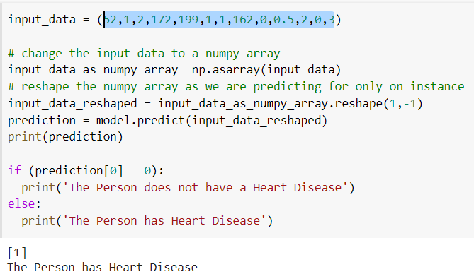
Building a Predictive System
Here we have opened our dataset file using notepad and copied random values without including last target value which we have to predict.
So in our predictive model we have putted the same values which we have copied from our notepad and it predicted target value correctly as 1. .
Figure 1
Figure 2

Slide 17
LIMITATIONS
Medical diagnosis is considered as a significant yet intricate task that needs to be carried out
precisely and efficiently. The automation of the same would be highly beneficial. Clinical
decisions are often made based on doctor’s intuition and experience rather than on the
knowledge rich data hidden in the database. This practice leads to unwanted biases, errors and
excessive medical costs which affects the quality of service provided to patients.

Slide 18
Python Libraries used:
1.
2.
3.
4.
5.
PANDAS
NUMPY
MATPLOTLIB
SEABORN
SKLEARN
TOOLS USED: Google Colaboratory, Microsoft excel
LANGUAGE : Python

Slide 19
CONCLUSION / FUTURE WORK
We use some libraries provided by Python to implement this project. After creating model, the algorithm of Logistic Regression gives us the test accuracy, which is 81.96%. Though we get a good result of 81.96% accuracy, that is not enough because it cannot guarantee that no wrong diagnosis happens. To improve accuracy, we hope to require more dataset. There are many possible improvements that could be explored to improve the scalability and accuracy of this prediction system. In the future, to predict disease we want to try different diseases such as lung cancer and want to apply more models to this project to gain more accuracy.

Slide 20
Thank you!

